Slide 1




A Social Initiative by
TITAN Design Impact Challenge Project Submission
Ecosystem Development Partners

Slide 2
A Social Initiative by
Index
Team Name - Ignite
Team Members- Abhishek Bhat P
Akshay B Gambhir
Chirag Shetty
Akshay Shettigar
Sahyadri College Of Engineering And Management Managluru
23 - 24th August 2025

Slide 3
A Social Initiative by
What problem are you trying to solve?
SUSTAINING CLEANLINESS IN BEACHES
Manual deep cleaning of beach waste is labor-intensive, inefficient, and unsustainable.
While staff are deployed for cleanup, there is little public accountability in maintaining
beach hygiene.
Waste continues to wash ashore from estuaries, adding to non-seasonal dumping sites

Slide 4
A Social Initiative by
What is the root cause of this problem?
1. Lack of proper disposal bins
Many beaches don’t have enough dustbins, or bins are overflowing.
2. No incentive for proper disposal
Visitors throw waste anywhere because it’s easier and they get nothing in return for using bins.
3. Low awareness & irresponsible behavior
People don’t realize the long-term damage to marine life and tourism
4. Inefficient waste collection system
Even if bins exist, collection trucks don’t empty them regularly.

Slide 5
A Social Initiative by
User Research Insights
Convenience matters → They don’t want to walk far to find a dustbin.
Awareness is low → Many don’t realize their waste ends up harming marine life.
No incentive → “Why should I carry a plastic bottle to a bin if I get nothing back?”
Behavioral habit → Some expect cleaners to manage it instead of themselves.

Slide 6
A Social Initiative by
Origin Story
One day our team visited a beach and saw piles of plastic and glass mixed with food waste.
Even though much of it was recyclable, it couldn’t be reused because of wrong segregation.
That incident made us realize the real problem is not the lack of bins, but the lack of motivation and awareness among people.

Slide 7
A Social Initiative by
Name of the Solution
The Smart Bin
It is an innovative waste collection and reward system designed to promote sustainable waste disposal through technology and incentives.
It uses QR/Barcode scanning, digital credits, and smart monitoring to encourage people to dispose of waste responsibly while creating a transparent and scalable eco-system.

Slide 8
A Social Initiative by
Working of the Solution
How does it work?
User Identification: Before disposing waste, the user scans the code on the Smart Bin or via a mobile app.
Waste Disposal: User drops waste (e.g., plastic bottle) into the bin.
The bin (or system) records the type of waste and logs the activity.
Credit Allocation: The system verifies the entry.
Eco-credits are automatically added to the user’s account in real time.
Tracking & Monitoring: Data of collected waste (type, quantity, location) is stored in a central database.
Authorities/municipalities can monitor disposal patterns.
Reward Redemption: Users can redeem credits at partnered shops or for discounts/offers.
Shopkeepers benefit by attracting eco-conscious customers

Slide 9
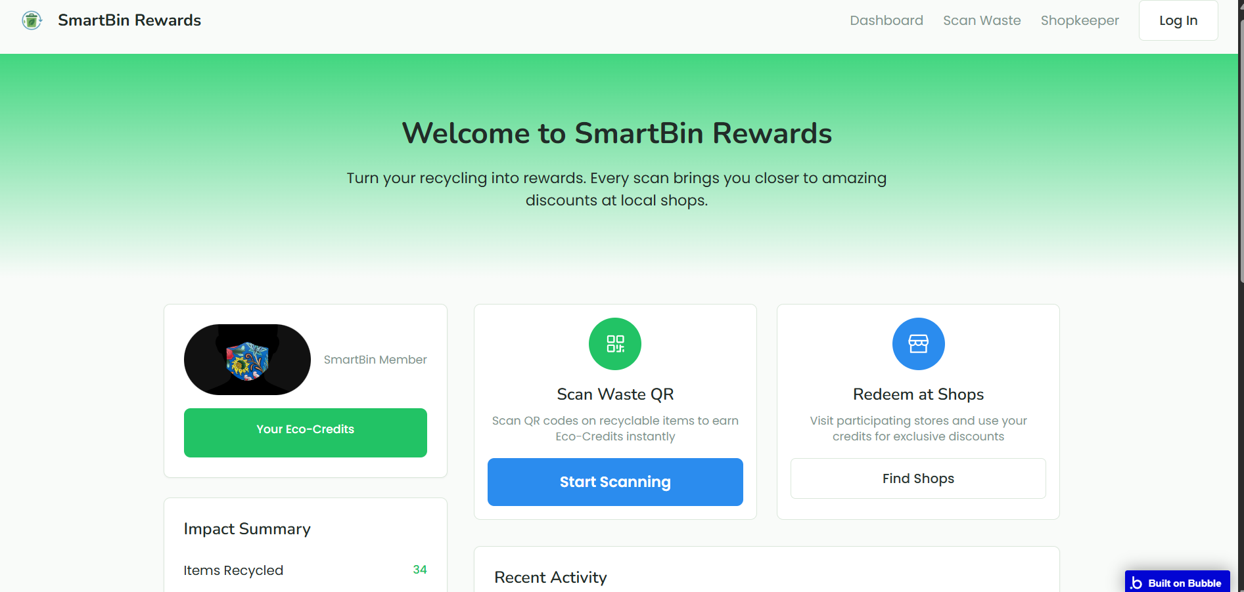
A Social Initiative by
Images/Links/Video of Your Solution
https://credit-93069.bubbleapps.io/version-test?debug_mode=true

Slide 10
A Social Initiative by
Target Audience
Urban Citizens / Local Residents
People living near beaches, public places, apartments, and markets.
They directly generate household and day-to-day waste.
Tourists & Visitors
Smart bins make waste disposal easy and rewarding.
Municipal Corporations / Local Government
They can use the system for waste tracking, segregation, and collection planning.
Reduces cost of manual cleanup
Schools & Colleges (Youth)
Students can be involved in gamified eco-credit competitions.
Builds long-term eco-friendly habits.

Slide 11
A Social Initiative by
Geographical Focus
1. Primary Target Area
The Smart Bin is designed for beach areas and coastal zones.
These are highly vulnerable and high-impact environments for waste mismanagement.
2. High Human Activity
Beaches attract thousands of daily visitors, Local residents, tourists, vendors, fishermen
3. Type of Waste Generated
Constant human activity produces large amounts of:
Single-use plastic bottles, Food packaging, Snack wrappers, Beverage cans
4. Unique Beach Challenge
Unlike cities, where waste is collected quickly, but in beaches waste is left directly on the sand and winds.
5. Rapid Pollution Risk
Waste on sand can flow into the sea within hours.
Once in the ocean, cleanup becomes almost impossible

Slide 12
A Social Initiative by
Research Support
Visual AI & Deep Learning for Waste Classification
Systems using CNN-based image recognition enable smart bins to automatically sort waste (plastic, glass, organic, etc.) in real time—preventing contamination and improving recycling rates.
Example: Arduino-controlled bins that refuse to open if the waste type doesn’t match.

Slide 13
A Social Initiative by
Supporting Documents
Smart Waste Management and Classification System for Smart Cities using Deep Learning
ResearchGate
https://www.researchgate.net/publication/360230167_Smart_Waste_Management_and_Classification_System_for_Smart_Cities_using_Deep_Learning
➝ Provides AI-driven segregation techniques applicable in high-footfall public areas such as beaches.

Slide 14
A Social Initiative by
Thank You
Manual deep cleaning of beach waste is labor-intensive, inefficient, and unsustainable. Despite staff deployment, lack of public accountability hampers long-term beach hygiene. Moreover, waste inflow from estuaries continues to replenish non-seasonal dumping sites, making current efforts inadequate.
“From Inefficiency to Innovation in Beach Cleaning.”

